Slide 1
Income attribution
Ib Hansen,
Danmarks Nationalbank
Basel February 10th

Slide 2
Explanation of the P/L of Danmarks Nationalbank
Two aproaches
  Accounting
  Business lines (risk factors)

Slide 3
The accountant approach
Net income from interest
  Net income from interest totaled kr. 3,368 million, which is 248 million less than in 2005.
  Income from interest on foreign assets fell by kr. 100 million to kr. 5,320 million. The decrease reflects a significantly smaller average foreign-exchange reserve, which is, however, by and large counterbalanced by increases in the level of interest rates.
  Net interest to banks and mortgage-credit institutes (interest on deposits and certificates of deposit less interest on monetary-policy lending[1]) decreased by kr.347 million to kr. 1,885 million. The decrease is attributable to the banks' significantly lower average net position, which is partly offset by interest-rate increases during the year.
  Danmarks Nationalbank's interest expenditure on the central government's deposit rose by kr. 125 million to kr. 1,298 million. The increase is due to the interest-rate increases during the year, which are partly offset by a significantly lower average deposit.
  Interest on domestic bonds fell by kr. 357 million to kr. 1,342 million. The decrease is attributable to a lower average holding and to lower interest rates on reinvestment.
Value adjustments, etc.
  Value adjustments resulted in a loss of kr. 690 million.
  Value adjustment of Danmarks Nationalbank's gold stock gave a gain of kr. 759 million, which is related to the increase in the price of gold converted to Danish kroner by 11 per cent during 2006.
  Value adjustment of foreign-exchange positions[2] resulted in a loss of kr. 780 million. The loss is due to a market-value loss of kr. 948 million, which is partly offset by an exchange-rate gain of kr. 168 million.
  The market-value loss on domestic securities of kr. 669 million can be related to a market-value loss on domestic bonds.
  Source: Danmarks Nationalbank's Report and Accounts 2006

Slide 4
Two types of risk
Policy driven (inevitable)
  Own currency appreciates
  Some credit risk
  Short rates
Return driven (voluntary)
  Interest rate risk
    More credit
    Other currencies fluctuates
    Equities ….

Slide 5
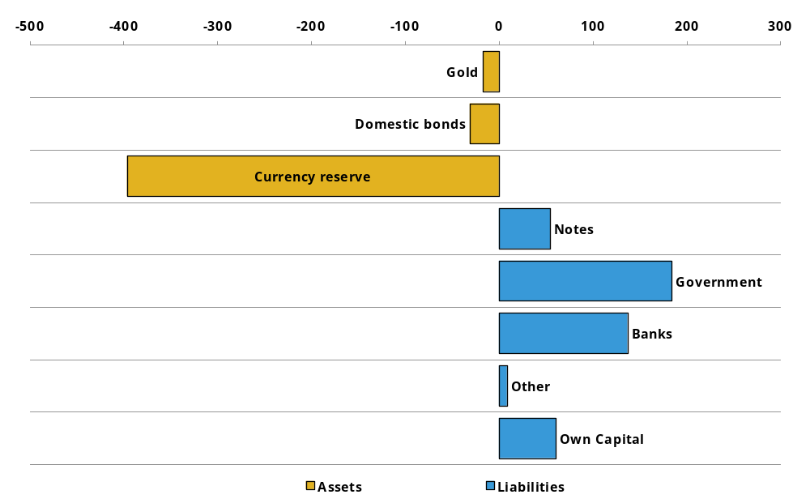
Balance sheet

Slide 6
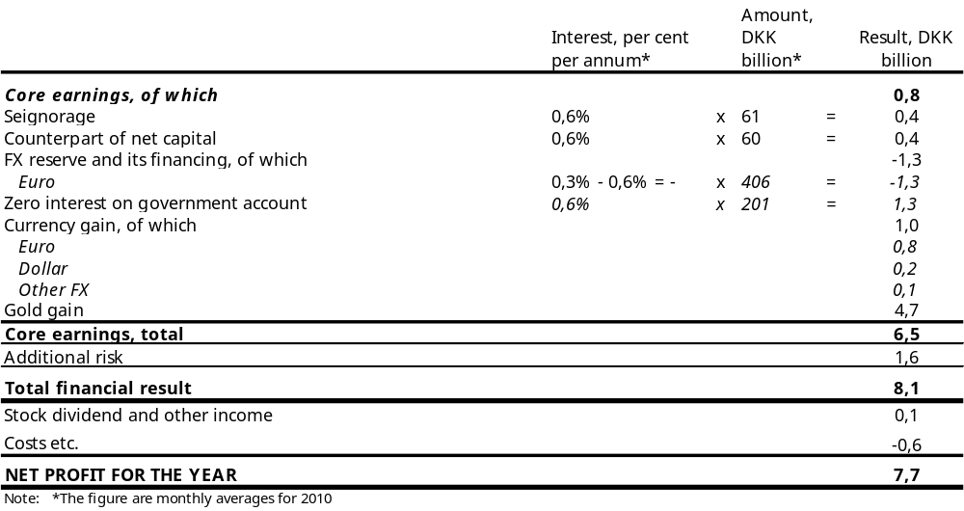
Calculating attribution from risk factors

Slide 7
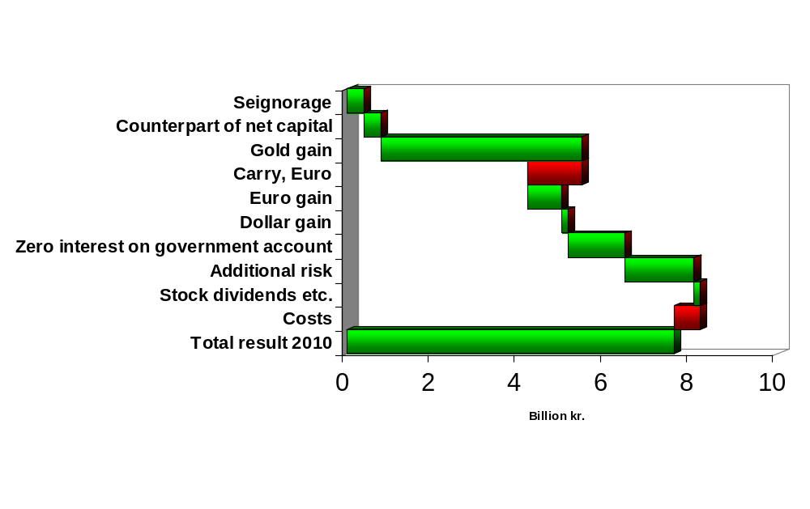
Lego Bricks (including costs)

Slide 8
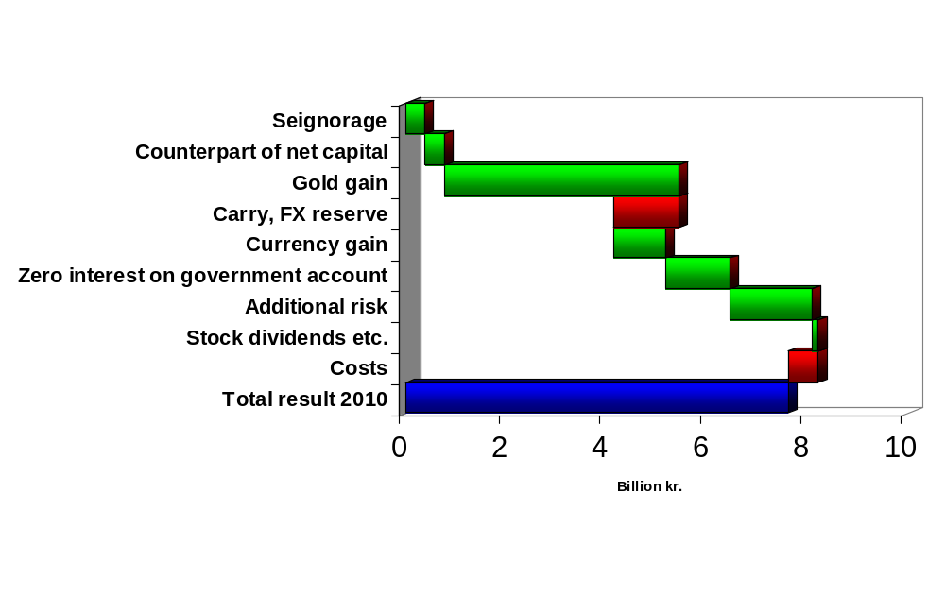
A simpler decomposition

Slide 9
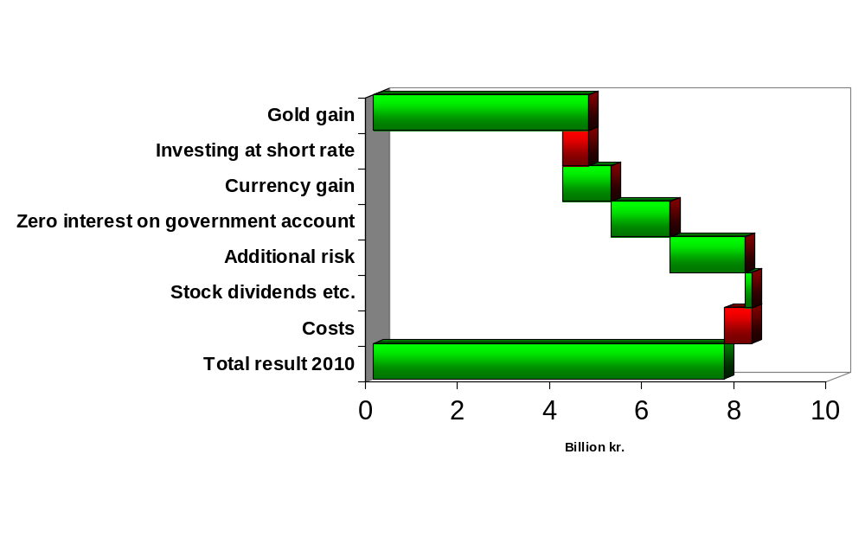
An even simpler decomposition

Slide 10
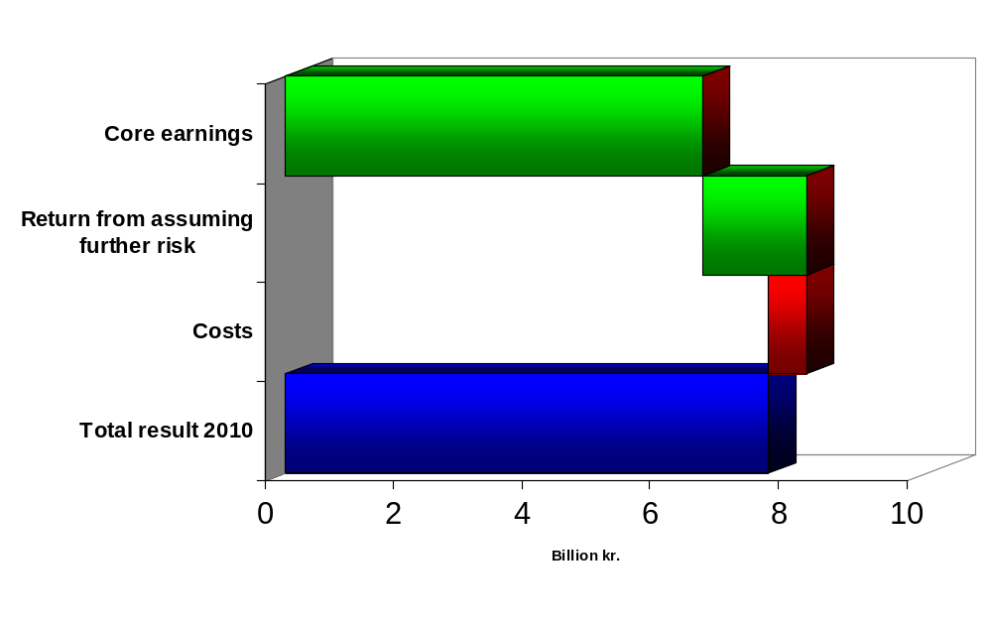
Policy- and return driven return

Slide 11
Accounting matter
All mark-to-market gain/loss hit the P/L
Realized and unrealized gains/loss:
  Are treated equally in the accounts
  Are not transferred to the government
  But transferred to a value adjustment reserve.
➔ Economic exposure =
Accounting exposure

Slide 12
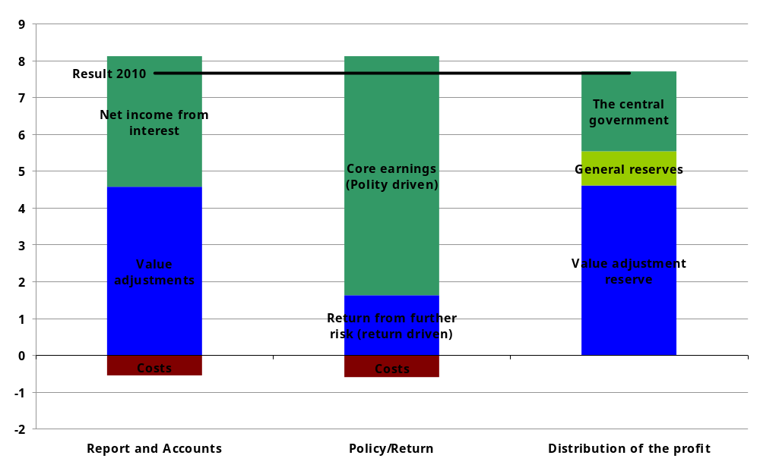
Different ways to decompose the result

Slide 13
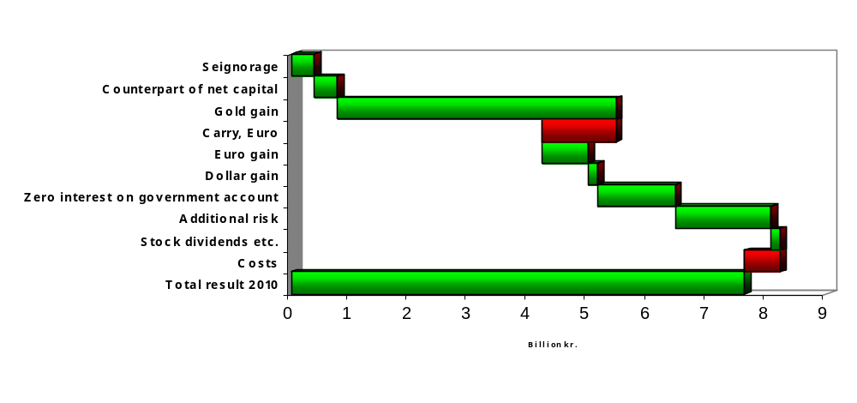
Spreadsheet template
Click on chart to input your own numbers

Slide 14
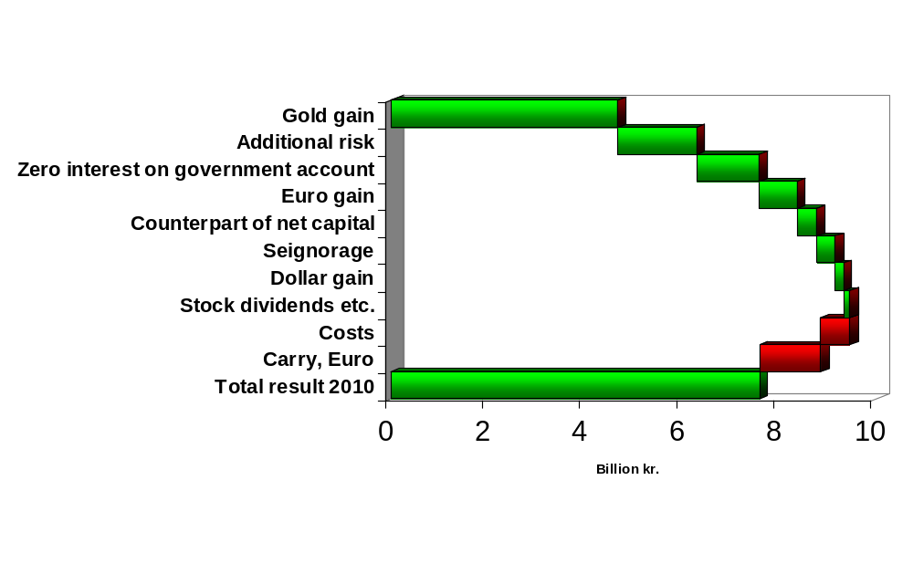
The contributions ordered by size

Slide 15
Summary
Develop understanding of drivers of return (and risk)
Focus on the big picture
Helps communication
Helps in deciding the risk aversion
Put some focus on the main drivers of profit

